Slide 1

Real Estate Valuation Analysis
Liezyl T. Bolotaulo
https://www.linkedin.com/in/liezyl-bolotaulo/

Slide 2
Contents
Business Problem
Business Research Objectives
Data collection and details
Exploratory Data Analysis
Visualization and Insights
Notes:
Change

Slide 3
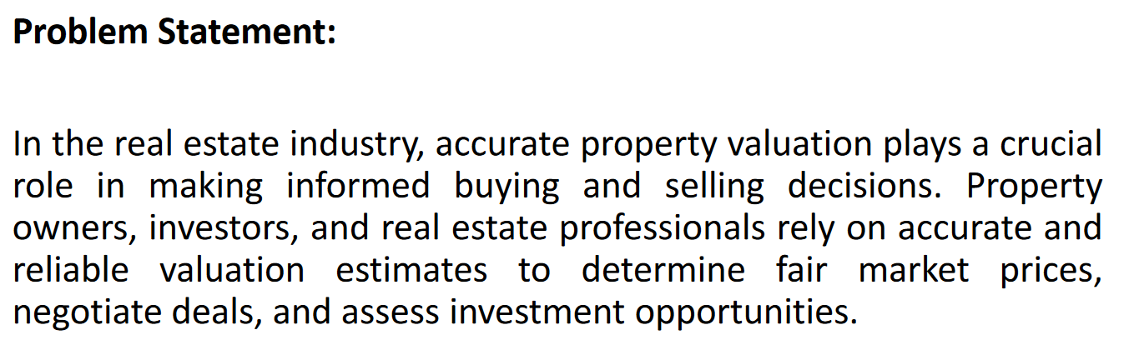

Slide 4


Slide 5
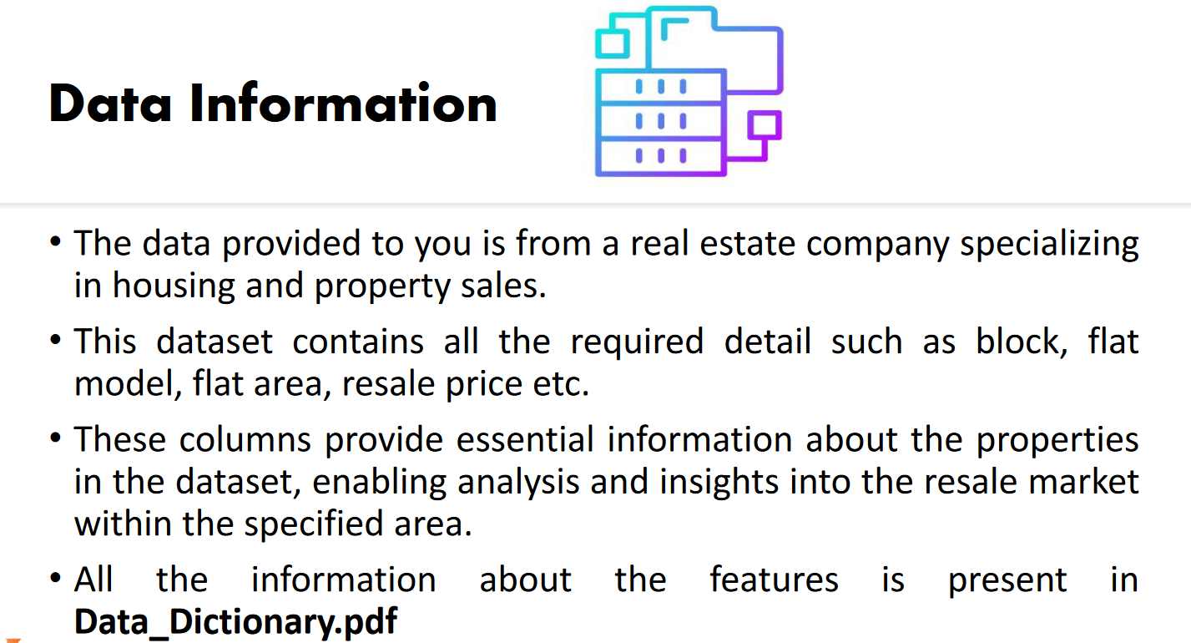
Data Collection and Understanding

Slide 6
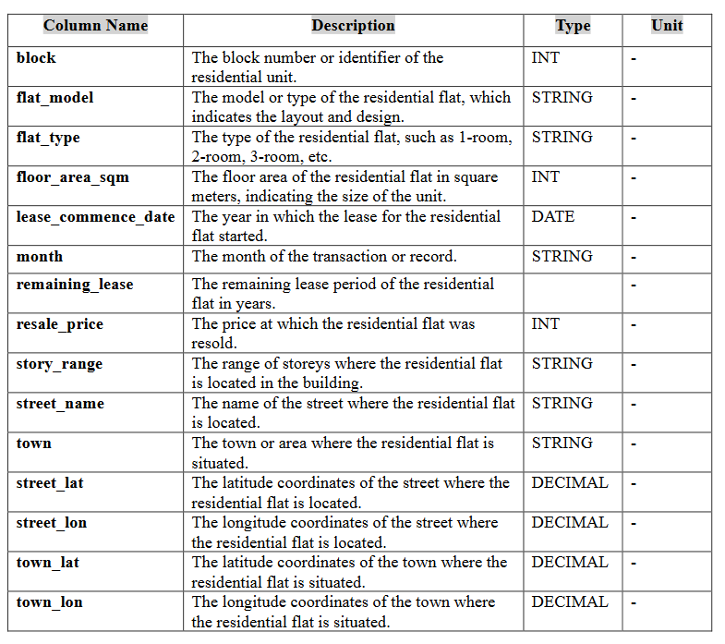
Data Information
Categorical Data
flat_model
flat_type
storey_range
town
Numerical Data
floor_area_sqm
lease_commence_date
month
remaining_lease
resale_price
street_lat
street_lon
town_lat
town_lon

Slide 7
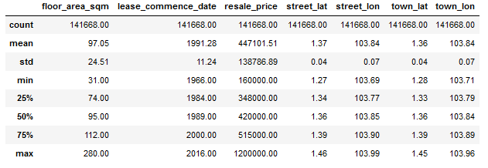
Exploratory Data Analysis [EDA]
Data Summary
Notes:
EDA is used for seeing what the data can tell us before the modeling task.
Change

Slide 8
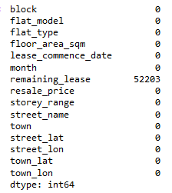
Missing Values Observation
Remaining_lease have 52,203 NA records. I replaced it with 0 value.

Slide 9
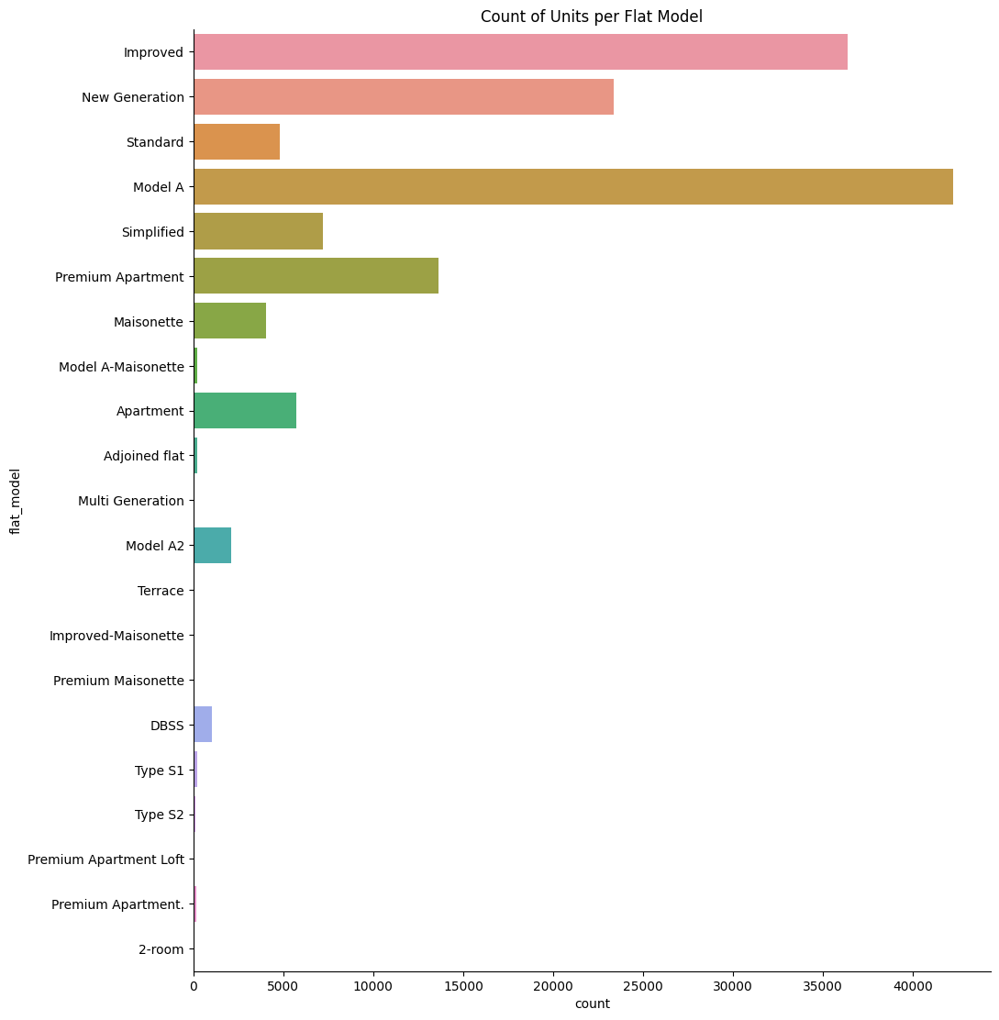
Visuals & Insights
Most of the properties belong to Model A (with more than 40,000 units available), followed by Improved and then New Generation respectively.
Notes:
Keep observations

Slide 10
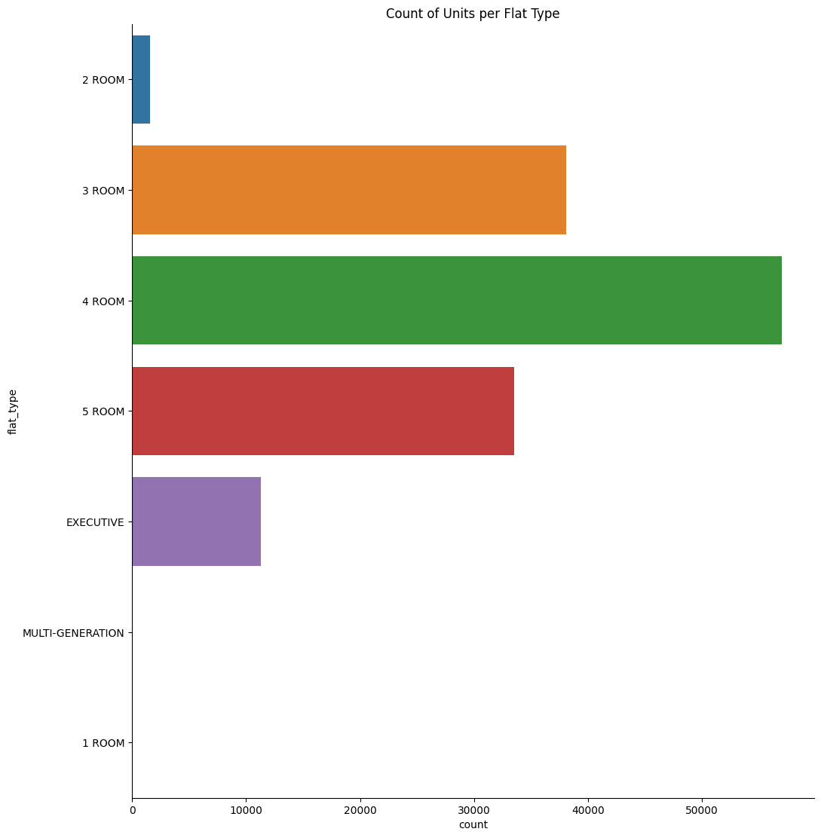
Visuals & Insights
Most of the available units are 4-Room types followed by 3 Rooms and then 5 Rooms.
Only a very few are Executive, 2 Room, Multi-Generation and 1 Room units.
Notes:
Keep observations

Slide 11
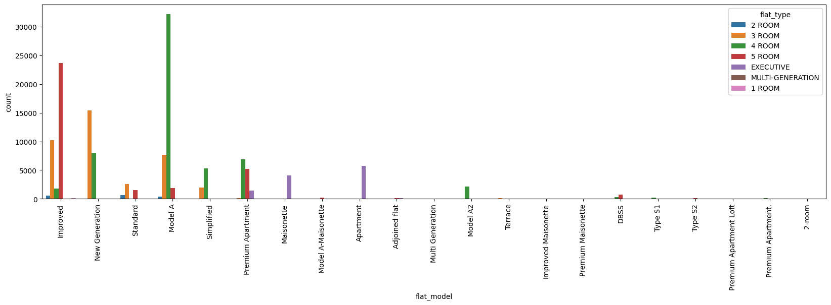
Visuals & Insights
The graph shows that more than 30,000 units with 4 Rooms belong to Model A which are mostly preferred by the owners.
Notes:
Keep observations

Slide 12
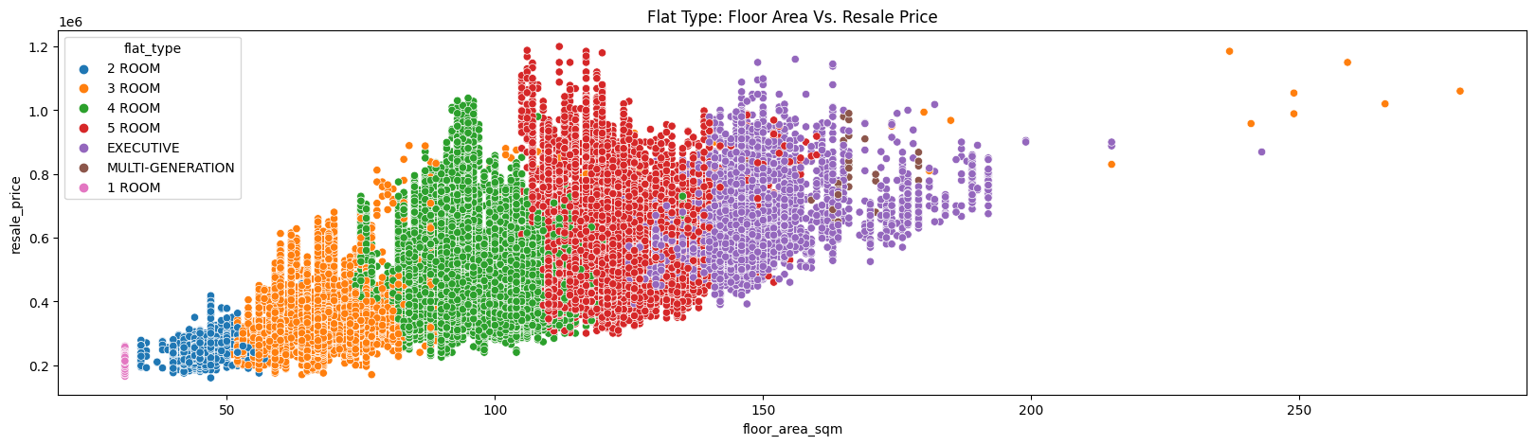
Visuals & Insights
The graph shows that there is a linear relationship between Flat Type, Floor Area per Square Meter and the Resale Price.
As the Flat Type increases its Room Features and as the floor area increases, the resale price also increases.
Notes:
Keep observations

Slide 13
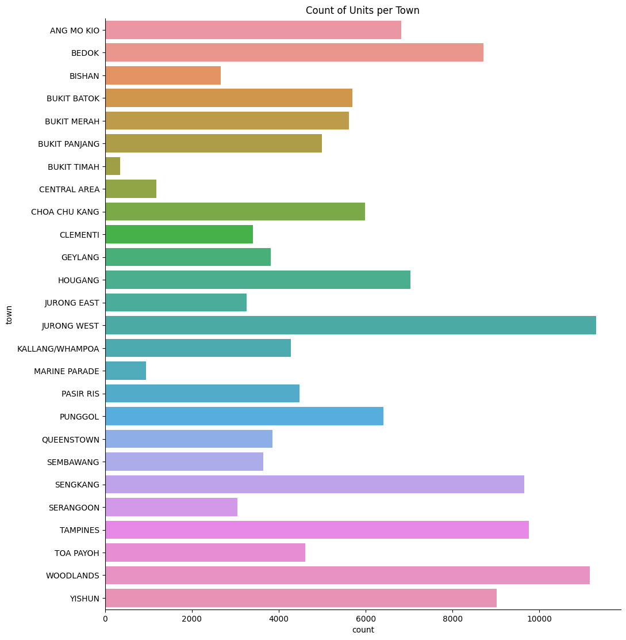
Visuals & Insights
The graph shows that most of the owners acquired properties in Jurong West and Woodlands, followed by Bedo, Sengkang and Tampines.
Only a very few acquired in Bukit Timah, Marine Parade and Central Area.
Notes:
Keep observations

Slide 14
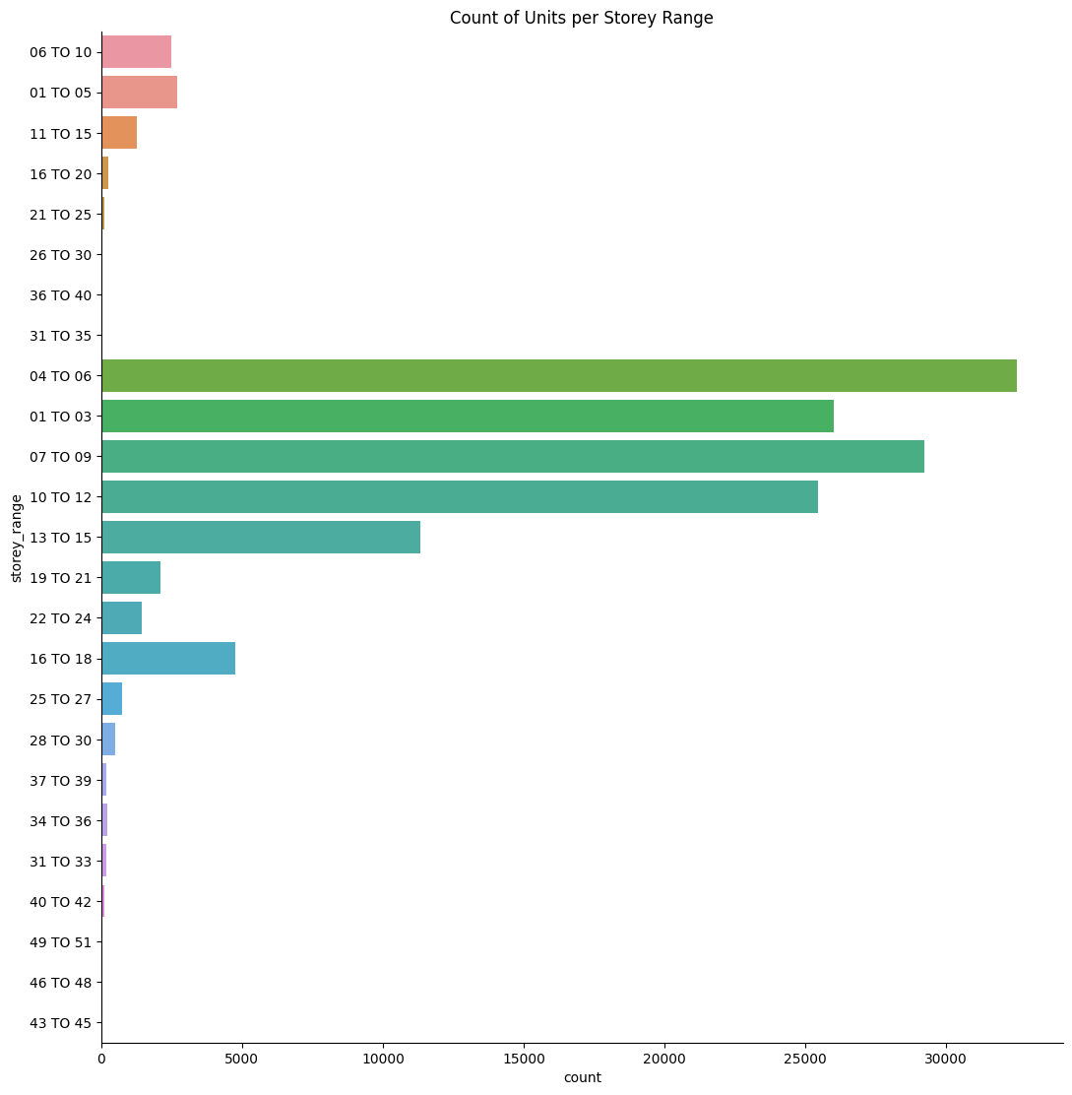
Visuals & Insights
The graph shows that most of the properties are between 4th to 9th floors
And only a very few to none are in the very high floors 26th to 45^{th.}
Notes:
Keep observations

Slide 15
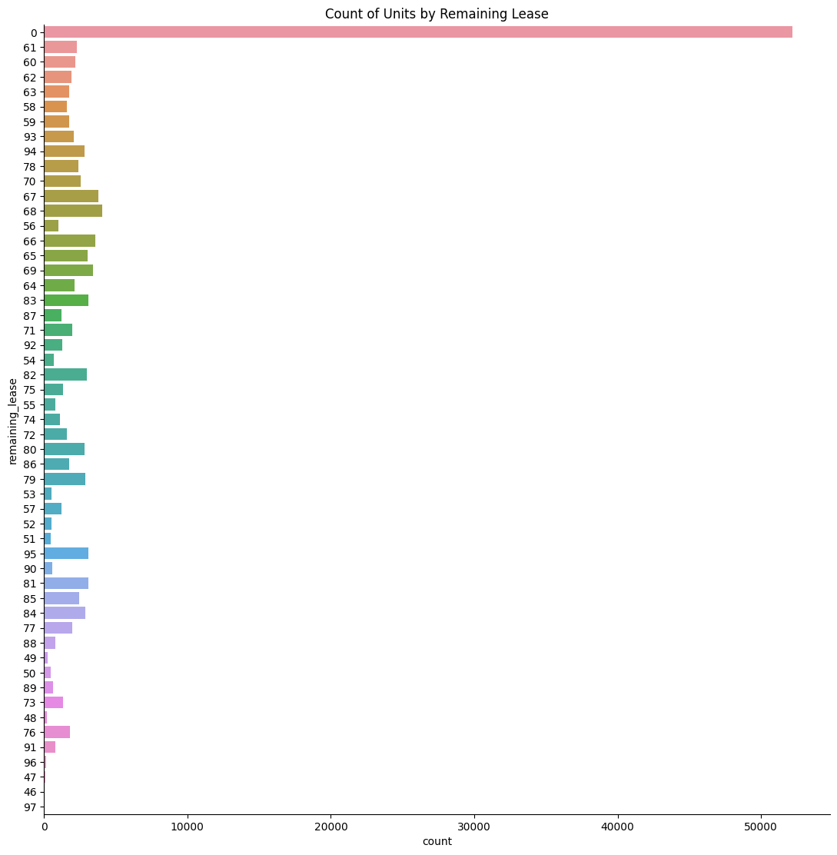
Visuals & Insights
The graph shows that around 37% of the properties don’t have remaining lease anymore while 63% still have remaining lease between 46 to 97 years.
Notes:
Keep observations

Slide 16
General Insights
In terms of location, Jurong West and Woodlands are the most preferred locations.
In terms of Flat Model, Model A are the most available properties.
In terms of Flat Type, the most available are 4 Room units.
In terms of pricing, we can see that the main factors are the model, type and area per square meters. When one increases, the other features also increases.
In terms of storey location, most of the available properties are between 4th to 9th floors
My overall evaluation of the data is that in acquiring a property, client has to always consider the needs such us family size to fit sufficiently in the property, number of rooms, which storey they prefer and location.

